Slide 1

Seo Coineanach na Càisge.
Cò ris a tha e coltach?
Notes:
Here’s the Easter Bunny. What is he like?

Slide 2
Tha cluasan mòra air.
Notes:
He has big ears.

Slide 3
Tha casan mòra air cuideachd.
Notes:
He has big feet too.

Slide 4
Tha earball beag molach air.
Notes:
He has a little fluffy tail.

Slide 5
Tha e glas agus geal.
Notes:
He is grey and white.

Slide 6
Tha sròn phinc air.
Notes:
He has a pink nose.

Slide 7
’S toigh leis a bhith a’ leum.
Notes:
He likes to be jumping.

Slide 8
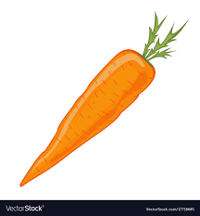
’S toigh leis a bhith ag ithe curran cuideachd.
Notes:
He likes to be eating a carrot too.

Slide 9
’S toigh leis clann agus bidh e a’ toirt uighean seòclaid dhaibh.
Notes:
He likes children and he likes to be giving chocolate eggs to them.

Slide 10
Saoil am bi e a’ toirt uighean seòclaid dhutsa…?
Notes:
I wonder if he’ll be giving chocolate eggs to you…?

